Slide 1


Microsoft Power BI Module 8 – Development With Power BI

Slide 2
Agenda
Data Alerts in Power Bl Service
Analyze in Excel
Power Bl Embedded playground
Features of Power Bl Mobile App
Power Bl Mobile App
Optimizing reports formobile App
Power BI API
Embedding Power Bl Contents in your application

Slide 3
Data Alerts in Power Bl Service

Slide 4
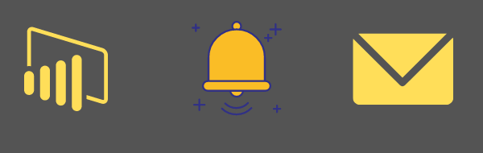
Data Alerts in Power Bl Service
Data Alerts are used to notify you when data in your dashboard changes beyond limits you set.
You can set alerts on tiles in your My Workspace. Alerts can only be set on tiles pinned from report
visuals, and only on gauges, KPIs, and cards.

Slide 5
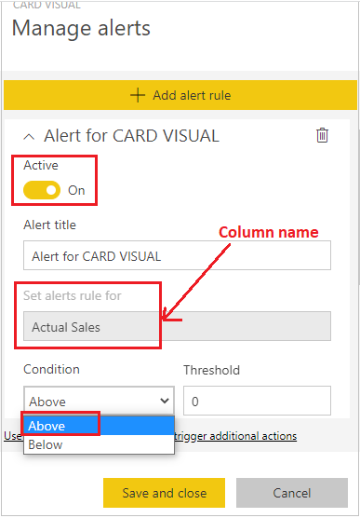
Data Alerts in Power Bl Service
If you have a Power Bl Pro license, you can set alerts on tiles in any other workspace, too.

Slide 6
Data Alerts in Power Bl Service
Setting an Alert
Tap a tile in a dashboard and click the bell icon
Add an alert
Select whether to receive hourly or daily alerts, and whether to also receive an email when you get the alert.
Change the alert tile(optionally)
Tap Save

Slide 7
Data Alerts in Power Bl Service
Receiving an Alert
Depending on the alert interval option we configured , Power Bl generates a new interval.
If the alert is configured to send a mail, the email will be sent.
Power Bl adds a message in the notification centre, and adds a new alert icon to the appliable tile

Slide 8
Demo: Data Alerts in Power Bl Service

Slide 9
Analyze in Excel

Slide 10
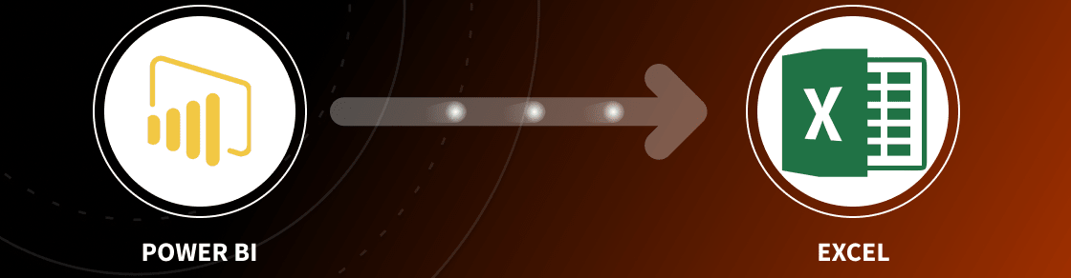
Analyze in Excel
Analyze in Excel feature brings Power BI datasets into Excel, and then view and interact with them using
PivotTables, charts, slicers, and other Excel features.
Install Analyze in Excel
Use Excel to Analyse data
Connect to Power BI Data
Share Workbook

Slide 11
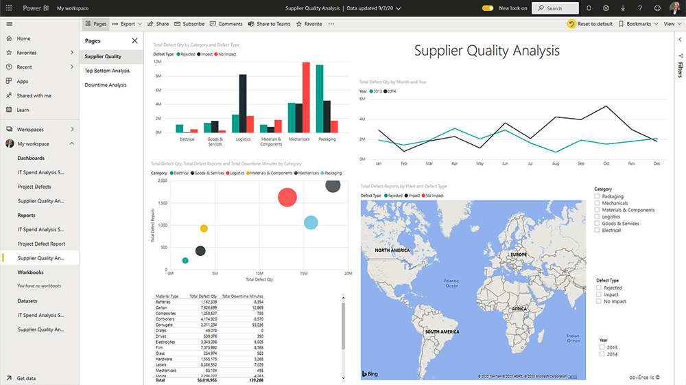
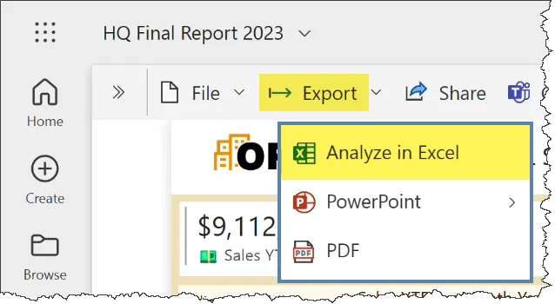

Analyze in Excel

Slide 12
Analyze in Excel
Limitations in Analyze in Excel are:
Analyze in Excel requires that the be in power BI Premium that the user have a Power BI pro license.
Guest users cannot use Analyze in Excel for datasets sent from (originating from) another tenant.
Analyze in Excel is a service feature, and is not available in Power BI Report Server or Power Bl Embedded.
Analyze Exel is only supported on computers running Microsoft windows.

Slide 13
Demo: Analyze in Excel

Slide 14
Power Bl API

Slide 15
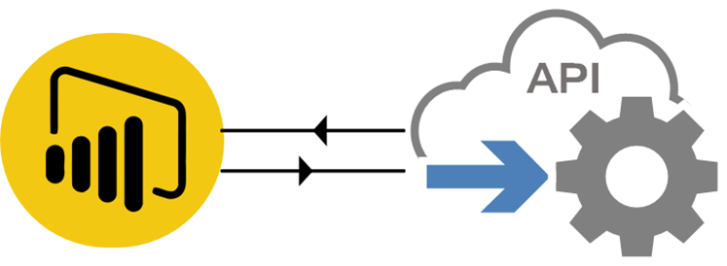
Power Bl API
The Power Bl API is a set of REST APIs from the Power Bl Service platform that enables you to interact with
Power Bl from your applications.

Slide 16
Power Bl API
Developers use API to push data into Power 81, display visuals from Power BI, and retrieve metadata about the objects in the service.
This enables in-house developers and independent software vendors (ISVs) to integrate Power Bl visuals, such as reports, tiles, dashboards, and Q&A content, into their own applications.

Slide 17
Power Bl API
We can use Power Bl API in three different forms
Power Bl REST API
Power Bl .NET SDK
Power Bl JavaScript API
A client-side library that you use to interact with your embedded content; for example, to filter a Power BI report displayed in your application.
A REST API that you use from any programming language that supports REST calls.
A wrapper to the Power BI API that you use from .NET languages to simplify your calls to the API.

Slide 18
Power Bl embedded analytics

Slide 19
Power Bl embedded analytics
It permits to embed reports, dashboards, and tiles from Power Bl in a web application or a website.
You can do the following with Power Bl embedded analytics:
01. Deliver compelling data experiences to end users, enabling them to take action based on insights from the solutions data.
02. Quickly and easily provide exceptional customer-facing reports, dashboards, and analytics in your own apps by using and branding Power Bl as our own.
03. Reduce developer resources by automating the monitoring, management, and deployment of analytics, while getting full control of Power Bl features and intelligent analytics.

Slide 20
Embedding Power Bl Content in your organization

Slide 21
Power API
Tasks performed using Power Bl APIS are:
01. Extending existing business workflows to push key data into a
Power Bl dashboard.
02. Embedding tiles into an app.
03. Embedding reports to an app.
04. Importing Power Bl Desktop (PBIX) files.
05. Authenticating Power Bl web apps.

Slide 22
Embedding Power Bl content in your organization
The Power Bl service (SaaS) and the Power Bl Embedded service in Azure (PaaS) have APIs for
embedding your dashboards and reports.
Embedding in these systems does not require any coding; you just create your Power Bl content then
configure the application to display it.
Embedding content
Embedding for your organization
Embedding for your customers

Slide 23
Embedding Power Bl content in your organization
You can easily embed Power Bl content into various Microsoft systems, including SharePoint Online,
Microsoft Teams, and Microsoft Dynamics 365.
SharePoint online
Publish your report to your Power BI account, get the URL for that report, and then use the URL for Power Bl web part on your SharePoint Online page
Dynamic 365
Enable Power Bl visualization embedding in Dynamics 365, and then add a Power BI dashboard or tile to your Dynamics ZES dashboard
Microsoft Teams
Add Power as a tab in your Microsoft Teams channel, and then select which reports to show in that channel.

Slide 24
Power Bl Embedded Playground

Slide 25
Power Bl Embedded Playground
The Power Bl Embedded Playground is a good starting place for learning about the Power Bl API.
For trying out Power Bl REST API operations without needing to write any code.
For using API calls to perform specific tasks against your data.

Slide 26
Power Bl Mobile App

Slide 27
Power Bl Mobile App
The Power BI mobile app is available for iOS, Android, and Windows IO mobile devices, enabling Power Bl users to
view reports and dashboards, and interact with data, from any location.
Dashboards automatically fit to the target screen, this means that there is no need for any
additional formatting, and no need to create resized visuals for mobile reports.

Slide 28
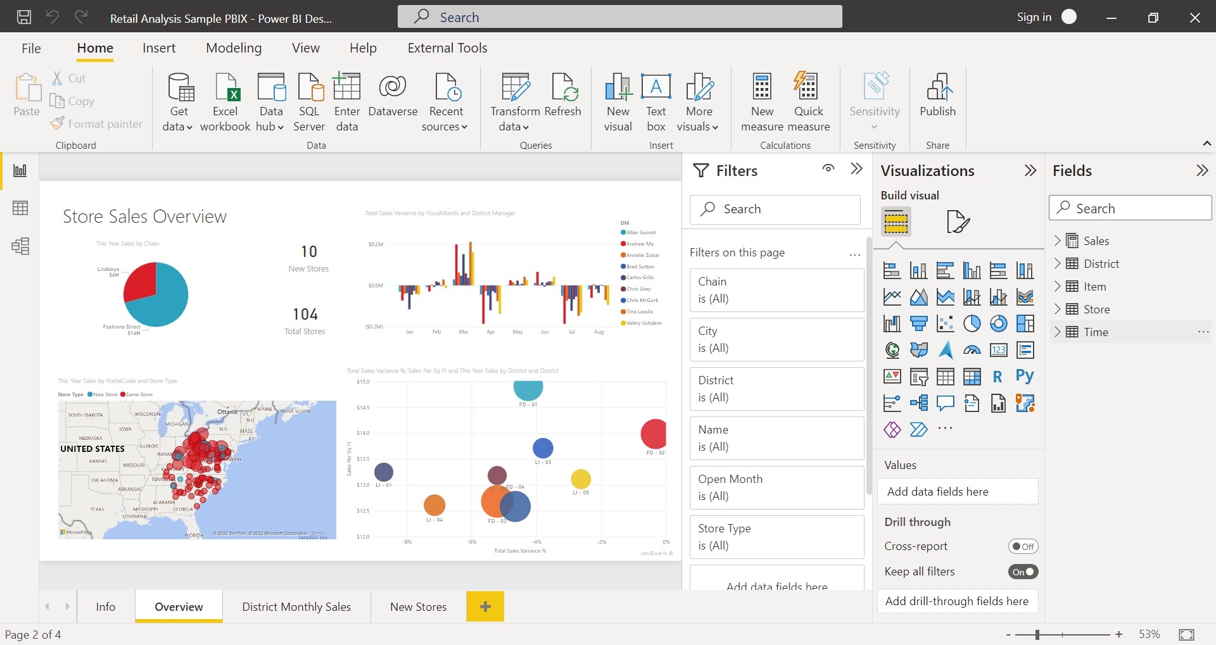
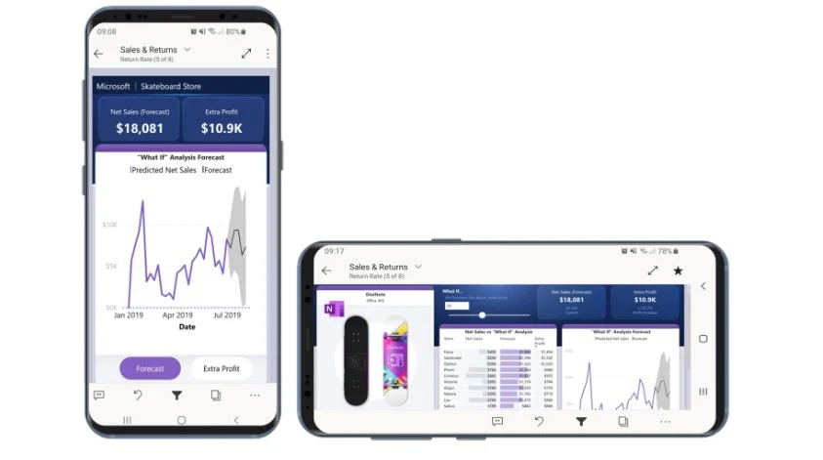
Power Bl Mobile App

Slide 29
Features of Power Bl Mobile App

Slide 30


Features of Power Bl Mobile App
View and interact with Power Bl Reports and Dashboards.
View dashboards in the landscape mode for the same experience as viewing on the Power Bl service portal.

Slide 31


Features of Power Bl Mobile App
Annotate and share tiles with colleagues
Scan QR code to open tiles directly

Slide 32


Features of Power Bl Mobile App
Set up data alerts on single figure tiles
Power Bl runs a background data refresh, so if you go offline, data remain reasonably up to date.

Slide 33
Optimizing reports for mobile App

Slide 34
Optimizing reports for mobile App
01. In Power Bl Service, toggle Web view to phone view.
02. In power Bl Desktop, open Report view and then click phone layout and then publish the report.
03 Optimize only the pages that require mobile layout.

